Slide 1


Dennis
2024.11.18

Slide 2

Outline
Executive Summary
Introduction
Methodology
Results
Conclusion
Appendix

Slide 3
Executive Summary
Summary of methodologies
Summary of all results

Slide 4
Introduction
SpaceX Falcon9 rocket launches usually cost less than other competitors. The reason of this is because of the reuse of the first stage of the launch.
This project is to estimate the SpaceX will reuse the first stage or not and use these information to determine the prices of launches.

Slide 5

Section 1

Slide 6
Methodology
Executive Summary
We use python to call the SpaceX API and the Wikipedia to collect data about the Falcon 9 launches.
After the collect stage, we use the BeautifulSoup parse the information and transfer to the pandas dataframe for the latter usage.
Perform exploratory data analysis (EDA) using visualization and SQL
Perform interactive visual analytics using Folium and Plotly Dash
Perform predictive analysis using classification models

Slide 7
Data Collection – SpaceX API
Call SpaceX API to get the data
Extract data from column
Filter Falcon9 launches
Handling the missing value
Call API
Extract data
Yes
Is Falcon9
https://github.com/CCChou/HW-for-IBM-DS/blob/main/capstone/jupyter-labs-spacex-data-collection-api.ipynb
Is value miss
Yes
Add mean

Slide 8
Data Collection - Scraping
Get data from wikipage URL
Parse data from table’s column and row
Transfer data to Pandas DataFrame object
Get data from wiki
Parse data from table
Transfer to dataframe
https://github.com/CCChou/HW-for-IBM-DS/blob/main/capstone/jupyter-labs-webscraping.ipynb

Slide 9
Data Wrangling
Describe how data were processed
You need to present your data wrangling process using key phrases and flowcharts
Add the GitHub URL of your completed data wrangling related notebooks, as an external reference and peer-review purpose
https://github.com/CCChou/HW-for-IBM-DS/blob/main/capstone/labs-jupyter-spacex-Data%20wrangling.ipynb

Slide 10
EDA with Data Visualization
Using Scatter plot to find the relationship between two variables
Using bar plot to find the highest successful rate with variables.
https://github.com/CCChou/HW-for-IBM-DS/blob/main/capstone/edadataviz.ipynb

Slide 11
EDA with SQL
Using bullet point format, summarize the SQL queries you performed
Add the GitHub URL of your completed EDA with SQL notebook, as an external reference and peer-review purpose
https://github.com/CCChou/HW-for-IBM-DS/blob/main/capstone/jupyter-labs-eda-sql-coursera_sqllite.ipynb

Slide 12
Build an Interactive Map with Folium
Summarize what map objects such as markers, circles, lines, etc. you created and added to a folium map
Explain why you added those objects
Add the GitHub URL of your completed interactive map with Folium map, as an external reference and peer-review purpose
https://github.com/CCChou/HW-for-IBM-DS/blob/main/capstone/lab_jupyter_launch_site_location.ipynb

Slide 13
Build a Dashboard with Plotly Dash
Add the scatter and pie chart for analysis.
Using pie chart can see the total successful rate in which site and can go deeper to find out the percentage of successful rate in each site.
Using the scatter plot can find out the relationship between payload mass and launch site.
https://github.com/CCChou/HW-for-IBM-DS/blob/main/capstone/dashboard.py

Slide 14
Predictive Analysis (Classification)
Compare Logistic Regression, Decision Tree, KNN, SVM models’ accuracy to choose the best model
Using GridSearchCV to find the best parameter for all models
The outcome shows the Decision Tree do the best job.
https://github.com/CCChou/HW-for-IBM-DS/blob/main/capstone/SpaceX_Machine%20Learning%20Prediction_Part_5.ipynb

Slide 15
Results
Exploratory data analysis results
Interactive analytics demo in screenshots
Predictive analysis results

Slide 16

Section 2

Slide 17
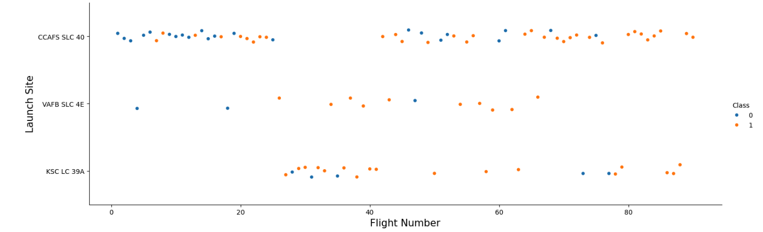
Flight Number vs. Launch Site
More flight number comes with more success in every launch site

Slide 18
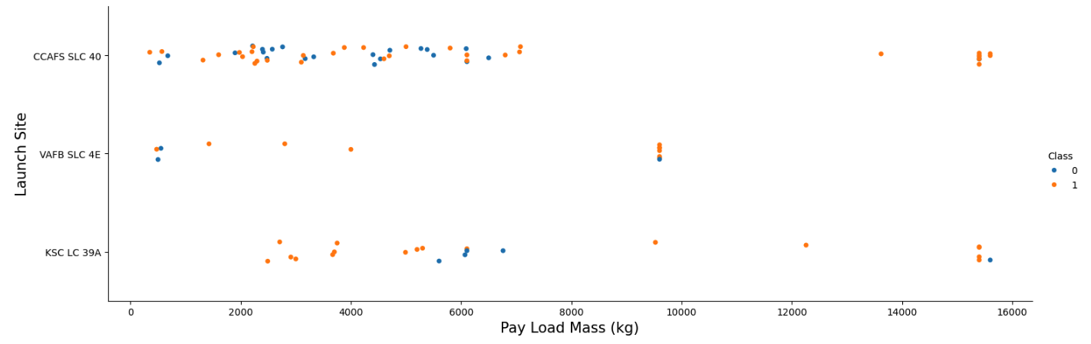
Payload vs. Launch Site
The VAFB-SLC launch site has no rockets launched for heavy payload
The KSC-LC launch site has more success for the light payload

Slide 19
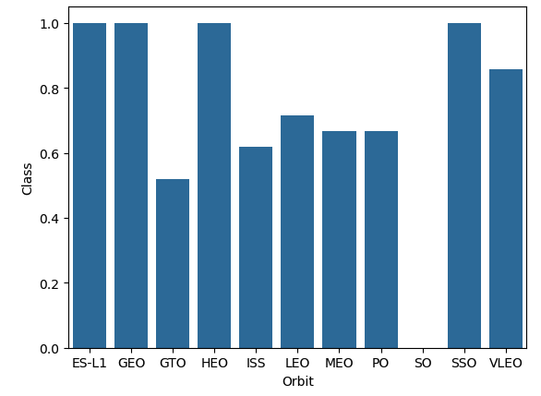
Success Rate vs. Orbit Type
The SO orbit never success
In ES-L1, GEO, HEO, SSO have more successes.

Slide 20
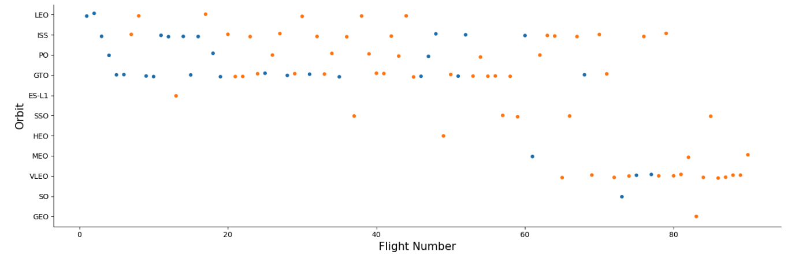
Flight Number vs. Orbit Type
It’s hard to find out there’s a relationship between orbit and flight number
However, in LEO orbit seems higher flight number comes with more successes

Slide 21
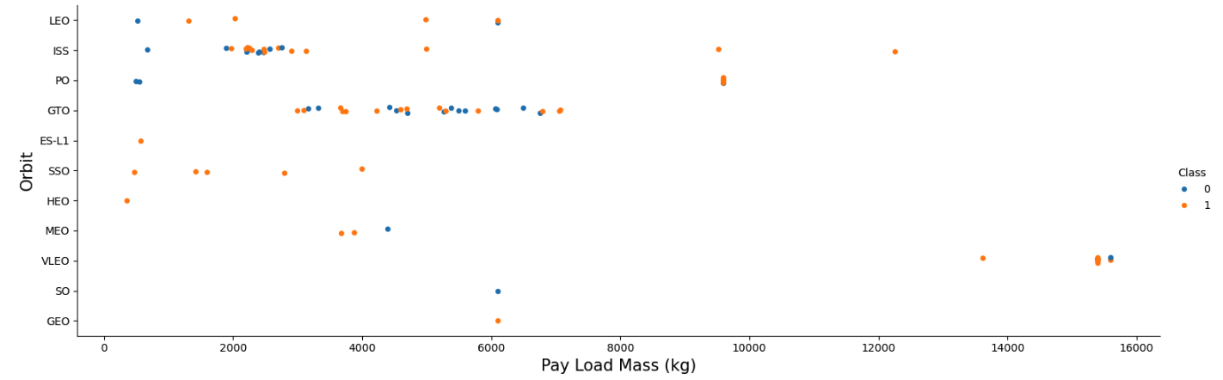
Payload vs. Orbit Type
For the scatter plot, it shows there seems no relationship between payload and orbit type

Slide 22
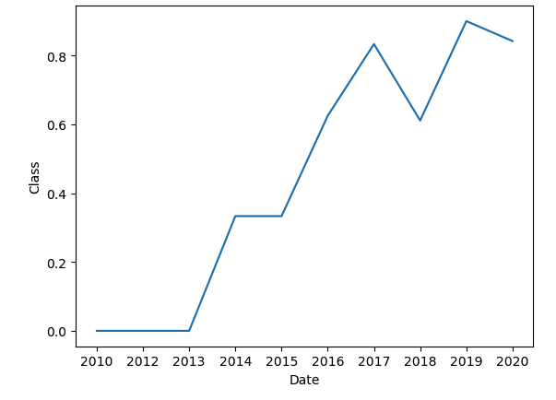
Launch Success Yearly Trend
Through the line chart you can say the successful rate increase when the year growth.
However, there’s some reason makes the successful rate fall in 2018

Slide 23
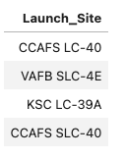
All Launch Site Names
As the figure shows there’s four launch site for Falcon 9.

Slide 24
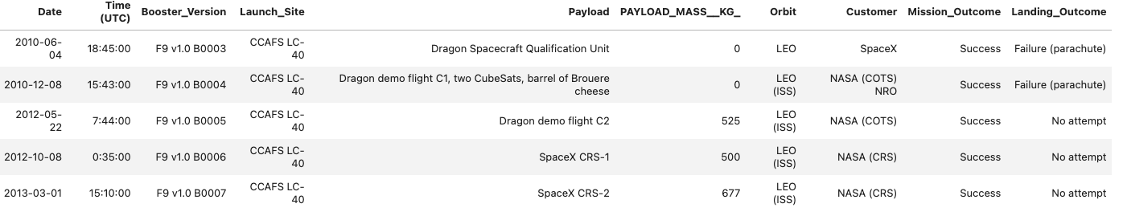
Launch Site Names Begin with 'CCA'
You can see the first 5 record shows that most of launch site’s orbit are LEO.
The launch records shows these 5 records are success for mission but landing usually not.

Slide 25
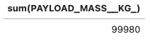
Total Payload Mass
The below figure shows the summary of payload mass is 99980 KG.

Slide 26
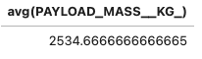
Average Payload Mass by F9 v1.1
The below figure shows the average of payload mass is 2534.67 KG for booster version which is F9 v1.1.

Slide 27
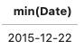
First Successful Ground Landing Date
The first successful ground landing is in 2015-12-22.

Slide 28
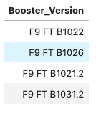
Successful Drone Ship Landing with Payload between 4000 and 6000
The figure shows the successful drone ship landing with payload between 4000 to 6000.
You could see the F9 FT series booster version is the most common version in this range with successful drone ship landing

Slide 29
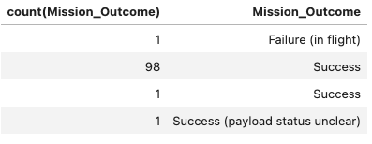
Total Number of Successful and Failure Mission Outcomes
In the figure you can find out there’s 101 launches and most of mission are success.
There four mission outcome type (perhaps there’s typo because the success show twice)

Slide 30
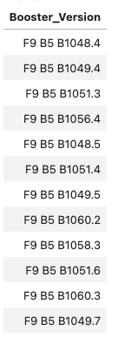
Boosters Carried Maximum Payload
There’s 12 booster version that carried maximum payload

Slide 31
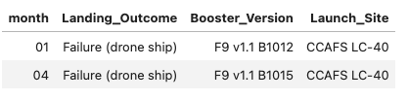
2015 Launch Records
In 2015 there’s two landing outcome are failure.
Both the failure records were launched from CCAFS LC-40

Slide 32
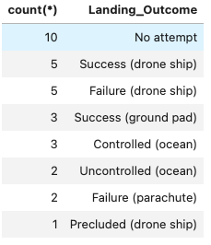
Rank Landing Outcomes Between 2010-06-04 and 2017-03-20
The maximum landing outcome between 2010-06-04 and 2017-03-20 is No attempt with the count 10.
The minimum landing outcome is Preclude (drone ship) with the count 1.

Slide 33

Section 3

Slide 34
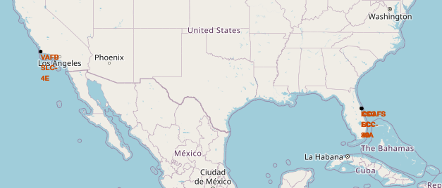
Map for Launches
As the map shows, we can find out the launch sites are all locate at the coast.
The launch sites located at both east and west coast.

Slide 35
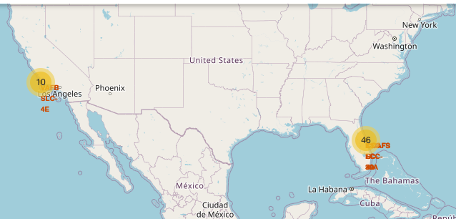
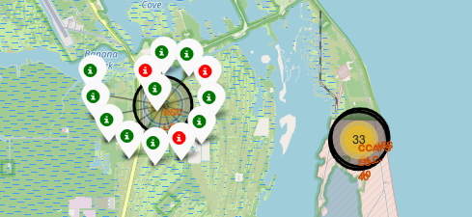
Map for Launches Successful Rate
As the Map can see we have total 56 launches on both east and west sites
For the most successful sites is the KSC LC-39A which has 10/13 successful rate

Slide 36
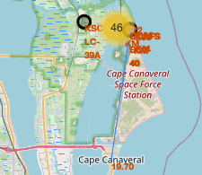
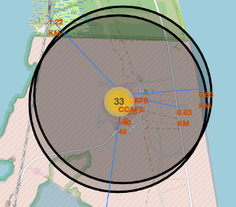
Map for the distance between launch site
As you can see the map shows the site is far from the city side but near coast.
This might show the best launch suppose take place at coast and should be away from city.

Slide 37

Section 4

Slide 38
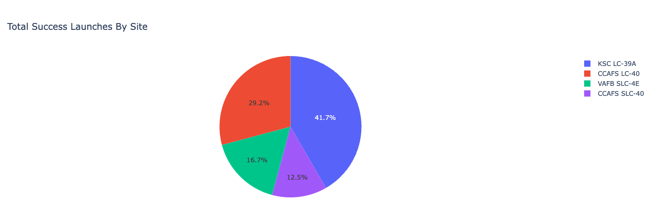
Total Success Launches By Site
Through the pie chart you can see the KSC LC-39A launch site has the highest successful rate.

Slide 39
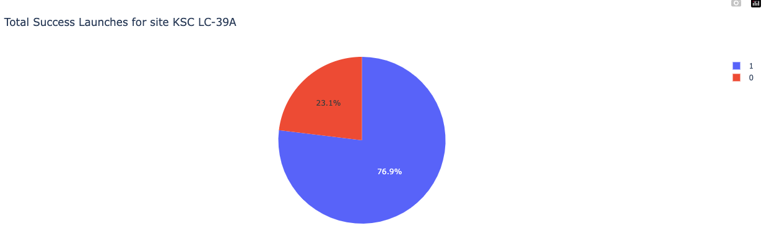
Total Success Launches for site KSC LC-39A
The KSC LC-39A launch site has 76.9% successful rate and only 23.1% failure.

Slide 40
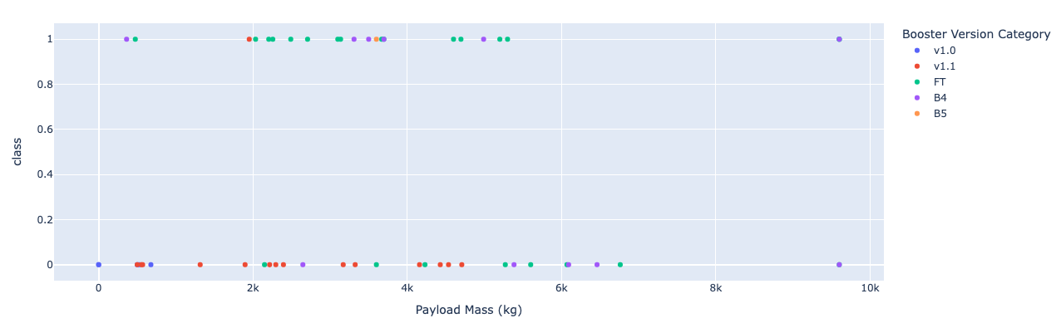
Scatter plot for all site with Payload Mass and Class
In the plot you can find out the booster version v.1.1 has the lowest successful rate.
The booster version FT has the highest successful rate in payload mass between 2k to 4k

Slide 41

Section 5

Slide 42
Classification Accuracy
In the table you can see the highest accuracy model is decision tree

Slide 43
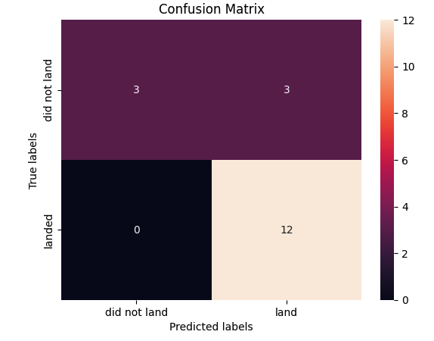
Confusion Matrix
The confusion matrix shows the models has 3 false negative errors.

Slide 44
Conclusions
The launch success or not is related to booster version, payload mass, orbit.
The Decision Tree can do the best prediction.

Slide 45
Appendix
All the resource could be found in https://github.com/CCChou/HW-for-IBM-DS/tree/main/capstone

Slide 46


